Slide 1
CSE 6179
Digital Forensics
Lecture 2
Forensic Investigation Process
Chapter 2 (DF – Wiley)

Slide 2
Overview
  Forensic Investigation Process
  Five Phases of DF Process
    Identification
    Collection
    Examination
    Analysis
    Presentation
  Characteristics of the Digital Forensic Investigation Process

Slide 3
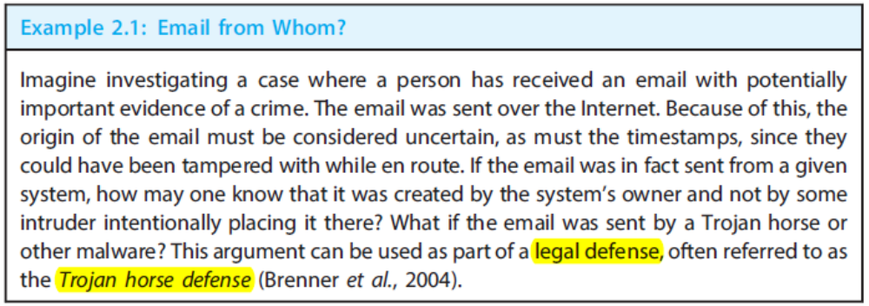
Forensic Investigation Process
Digital evidence
  computers, mobile devices, internet infrastructure, industrial systems, and other digital devices.
Forensic process and its underlying principles
  ensure that an investigation is forensically sound.
  Computer Forensics, Internet Forensics, Mobile Device Forensics.
The uncertainties associated with potential evidence, both physical and logical, accidental and deliberate, must be addressed in any forensic investigation.

Slide 4
Principles of a Forensics Process
Defines a structured investigation of digital evidence
A process or method can be considered forensically sound if it adheres to established digital forensics principles, standards, and processes.
The investigation should aim to find the strongest evidence with the resources available and also produce appropriate documentation of the investigation’s processes, key assumptions, and uncertainties.
The National Institute of Standards and Technology (NIST) has established a project to create a set of criteria for evaluating forensics tools. (Computer Forensics Tool Testing (CFTT) Project, www.cftt.nist.gov)

Slide 5
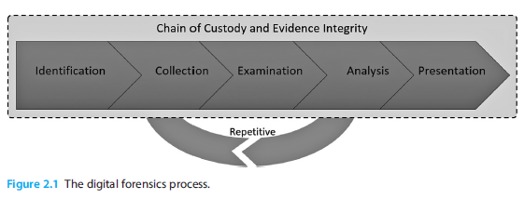
Digital Forensic Process
Identification: Verification of event, incident, or crime.
Collection: Evidence collection and acquisition of data.
Examination: Preparation and examination of data and potential evidence.
Analysis: Use of scientific methods to determine the facts about an incident or crime. (if any) and the significance of the evidence.
Presentation: Documentation and reporting of evidence found.

Slide 6
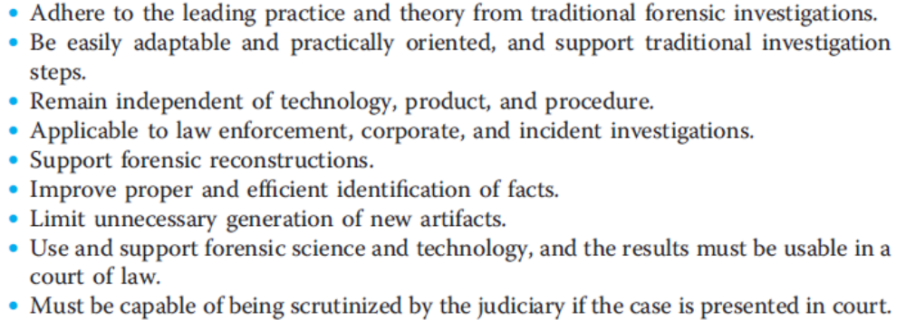
Characteristics of a digital forensics investigation process
Notes:
Thus, what we are not going to learn is how to give evidence in court, what the specific laws are in relation to computer misuse. Nor are we going to cover the various organisational policies that you may encounter.
Instead, we are here to focus solely on the area of digital investigation. Evidence, thus, has a meaning in investigative context, and not in terms of the context of legal admissibility.
Thus this leads to the idea that digital investigation is influenced by the context in which it is undertaken. This module is concerned with Digital investigation. The outcome of this investigation may be used for a Forensic Investigation as part of a criminal case against an individual, or it may be used as part of an internal process. This is something that we are not going to teach as part of this course, as it is out of our remit.

Slide 7
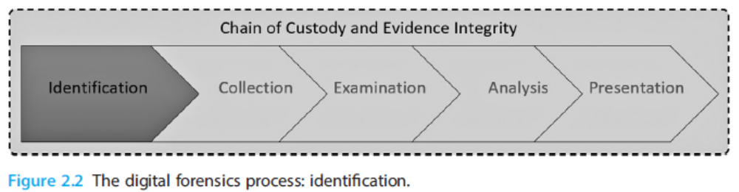
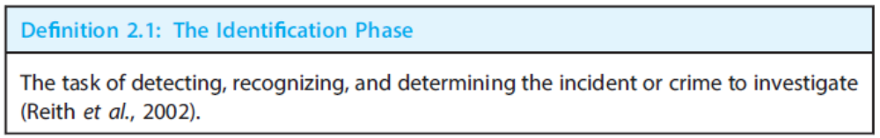
The Identification Phase
Notes:
Thus, what we are not going to learn is how to give evidence in court, what the specific laws are in relation to computer misuse. Nor are we going to cover the various organisational policies that you may encounter.
Instead, we are here to focus solely on the area of digital investigation. Evidence, thus, has a meaning in investigative context, and not in terms of the context of legal admissibility.
Thus this leads to the idea that digital investigation is influenced by the context in which it is undertaken. This module is concerned with Digital investigation. The outcome of this investigation may be used for a Forensic Investigation as part of a criminal case against an individual, or it may be used as part of an internal process. This is something that we are not going to teach as part of this course, as it is out of our remit.

Slide 8
The Identification Phase (contd.)
Preparations and Deployment of Tools and Resources:
  Proper planning helps prevent poor performance or substandard results in an investigation and a precondition for an efficient and effective investigation.
  The choice of tools depends on the resources available and the ambition and objective of the agency or unit.
  The forensic soundness of the tools must be assessed, as they have to support the principles of evidence integrity and chain of custody.
The First Responder:
  Responsible for handling potential evidence, including digital devices.
  A digital forensics investigation is a response to an observed incident and the first responder must act accordingly.
Notes:
Thus, what we are not going to learn is how to give evidence in court, what the specific laws are in relation to computer misuse. Nor are we going to cover the various organisational policies that you may encounter.
Instead, we are here to focus solely on the area of digital investigation. Evidence, thus, has a meaning in investigative context, and not in terms of the context of legal admissibility.
Thus this leads to the idea that digital investigation is influenced by the context in which it is undertaken. This module is concerned with Digital investigation. The outcome of this investigation may be used for a Forensic Investigation as part of a criminal case against an individual, or it may be used as part of an internal process. This is something that we are not going to teach as part of this course, as it is out of our remit.

Slide 9
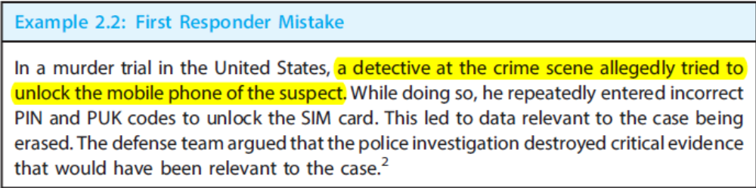
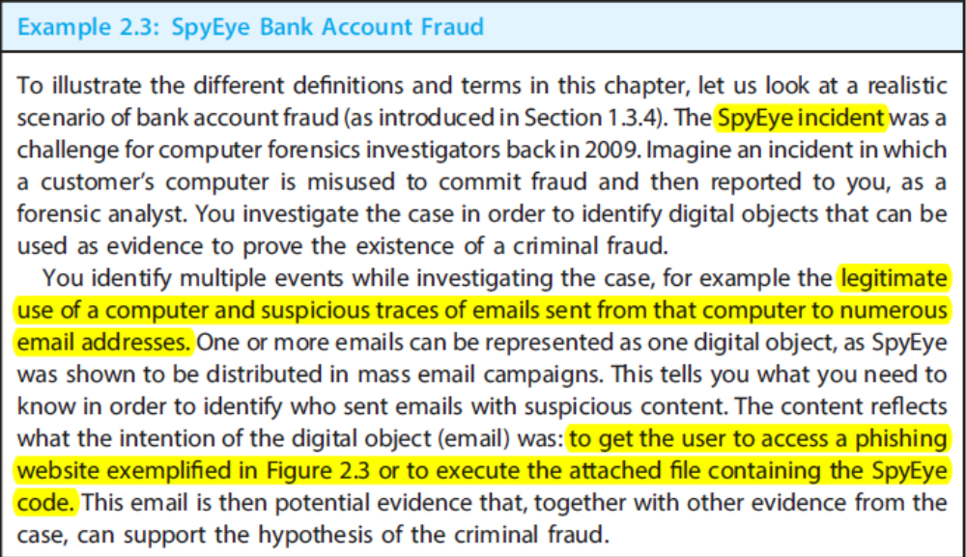
The Identification Phase (contd.)
Notes:
Thus, what we are not going to learn is how to give evidence in court, what the specific laws are in relation to computer misuse. Nor are we going to cover the various organisational policies that you may encounter.
Instead, we are here to focus solely on the area of digital investigation. Evidence, thus, has a meaning in investigative context, and not in terms of the context of legal admissibility.
Thus this leads to the idea that digital investigation is influenced by the context in which it is undertaken. This module is concerned with Digital investigation. The outcome of this investigation may be used for a Forensic Investigation as part of a criminal case against an individual, or it may be used as part of an internal process. This is something that we are not going to teach as part of this course, as it is out of our remit.

Slide 10
The Identification Phase (contd.)
At the Scene of the Incident:
  The location (or set of locations) where an incident took place or evidence is found.
  Compared to small businesses, large businesses generally practice stricter control of digital devices and equipment, and separate IT departments.
  Log analysis has become a fundamental IT operations capability that can also facilitate forensic readiness.
  Preservation Tasks:
    The processing of potential evidence, and preserve the chain of custody and evidence integrity.
    The documentation enables reproducibility of results and traceability from the physical object’s origin to the final evidence presentation.
Notes:
Thus, what we are not going to learn is how to give evidence in court, what the specific laws are in relation to computer misuse. Nor are we going to cover the various organisational policies that you may encounter.
Instead, we are here to focus solely on the area of digital investigation. Evidence, thus, has a meaning in investigative context, and not in terms of the context of legal admissibility.
Thus this leads to the idea that digital investigation is influenced by the context in which it is undertaken. This module is concerned with Digital investigation. The outcome of this investigation may be used for a Forensic Investigation as part of a criminal case against an individual, or it may be used as part of an internal process. This is something that we are not going to teach as part of this course, as it is out of our remit.

Slide 11
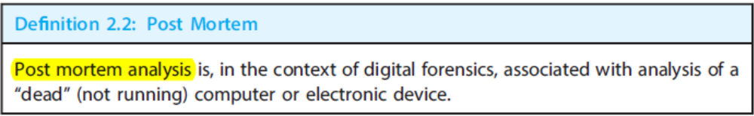
The Identification Phase (contd.)
Dealing with Live and Dead Systems:
  Live systems: systems that are running and are at the time of identification potentially holding evidence that may be lost or hard to acquire if the system is shutdown.
  Dead systems: systems not running. Any data in temporary storage are as such as cache, main memory, running processes, or active application dialogues on a computer will normally be lost when the system is powered down.
  Special caution must be taken before any action, regardless of whether the system is live or dead at the time of identification. Critical data may not be retrievable if a system is turned off.
  Turning on a system that was initially turned off might also lead to evidence loss. At boot time, a PC, mobile phone, or media player executes boot activities that can overwrite previously cached data.
  Cellphones, media players, laptops, or any devices that can communicate over any network can potentially be altered while being seized or even after they have been seized. This can be caused by either deliberate tampering or unintentional changes (e. g., due to humidity or electricity).
Notes:
Thus, what we are not going to learn is how to give evidence in court, what the specific laws are in relation to computer misuse. Nor are we going to cover the various organisational policies that you may encounter.
Instead, we are here to focus solely on the area of digital investigation. Evidence, thus, has a meaning in investigative context, and not in terms of the context of legal admissibility.
Thus this leads to the idea that digital investigation is influenced by the context in which it is undertaken. This module is concerned with Digital investigation. The outcome of this investigation may be used for a Forensic Investigation as part of a criminal case against an individual, or it may be used as part of an internal process. This is something that we are not going to teach as part of this course, as it is out of our remit.

Slide 12
The Identification Phase (contd.)
Chain of Custody:
  Chronological documentation that records the sequence of custody, control, transfer, analysis, and disposition of physical or electronic evidence.
  Copy (or “clone”) the raw data from the device, which we believe has something to do with a crime before we can start searching for evidence of the crime in question.
  Do not alter or change the data stored on the device during the copying process (write-blocking technology)
  The documentation of these tasks is crucial to preserving the chain of custody.
  After copying, we generate a digital signature of the storage media by using a cryptographic hash function, compare to the original to verify that they are identical to supports the chain of custody and evidence integrity.
Notes:
Thus, what we are not going to learn is how to give evidence in court, what the specific laws are in relation to computer misuse. Nor are we going to cover the various organisational policies that you may encounter.
Instead, we are here to focus solely on the area of digital investigation. Evidence, thus, has a meaning in investigative context, and not in terms of the context of legal admissibility.
Thus this leads to the idea that digital investigation is influenced by the context in which it is undertaken. This module is concerned with Digital investigation. The outcome of this investigation may be used for a Forensic Investigation as part of a criminal case against an individual, or it may be used as part of an internal process. This is something that we are not going to teach as part of this course, as it is out of our remit.

Slide 13
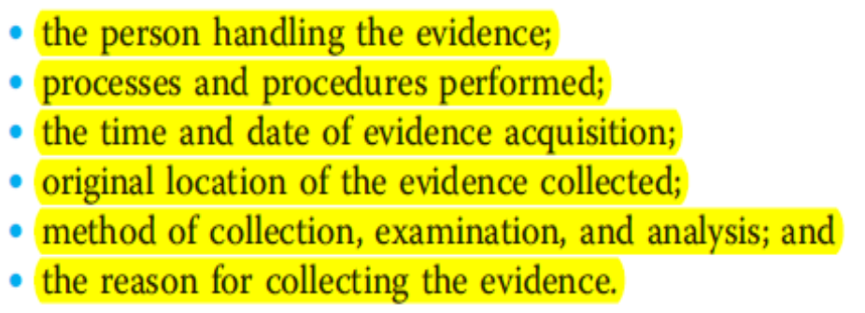
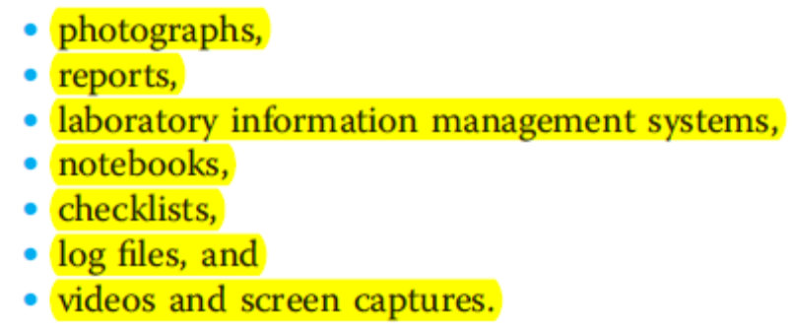
The Identification Phase (contd.)
Chain of Custody (contd.):
  All changes, such as copying, case information, and information about how it was collected and who was involved, must be documented.
  Multiple tools can be used to collect the data and to generate a hash to avoid any uncertainties in the tools used (dual-tool verification).
  Documented information should cover the following:
  Various kinds of supporting data and documents may be used for supporting the chain of custody, for example:
Notes:
Thus, what we are not going to learn is how to give evidence in court, what the specific laws are in relation to computer misuse. Nor are we going to cover the various organisational policies that you may encounter.
Instead, we are here to focus solely on the area of digital investigation. Evidence, thus, has a meaning in investigative context, and not in terms of the context of legal admissibility.
Thus this leads to the idea that digital investigation is influenced by the context in which it is undertaken. This module is concerned with Digital investigation. The outcome of this investigation may be used for a Forensic Investigation as part of a criminal case against an individual, or it may be used as part of an internal process. This is something that we are not going to teach as part of this course, as it is out of our remit.

Slide 14
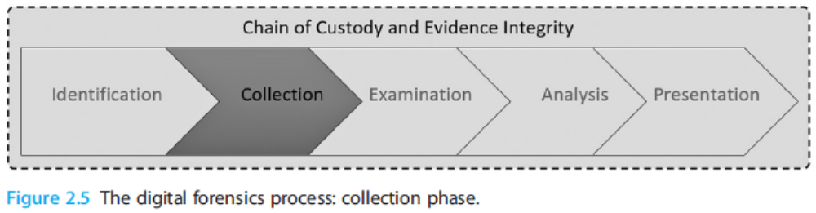
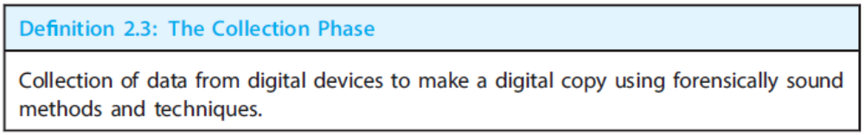
The Collection Phase
Notes:
Thus, what we are not going to learn is how to give evidence in court, what the specific laws are in relation to computer misuse. Nor are we going to cover the various organisational policies that you may encounter.
Instead, we are here to focus solely on the area of digital investigation. Evidence, thus, has a meaning in investigative context, and not in terms of the context of legal admissibility.
Thus this leads to the idea that digital investigation is influenced by the context in which it is undertaken. This module is concerned with Digital investigation. The outcome of this investigation may be used for a Forensic Investigation as part of a criminal case against an individual, or it may be used as part of an internal process. This is something that we are not going to teach as part of this course, as it is out of our remit.

Slide 15
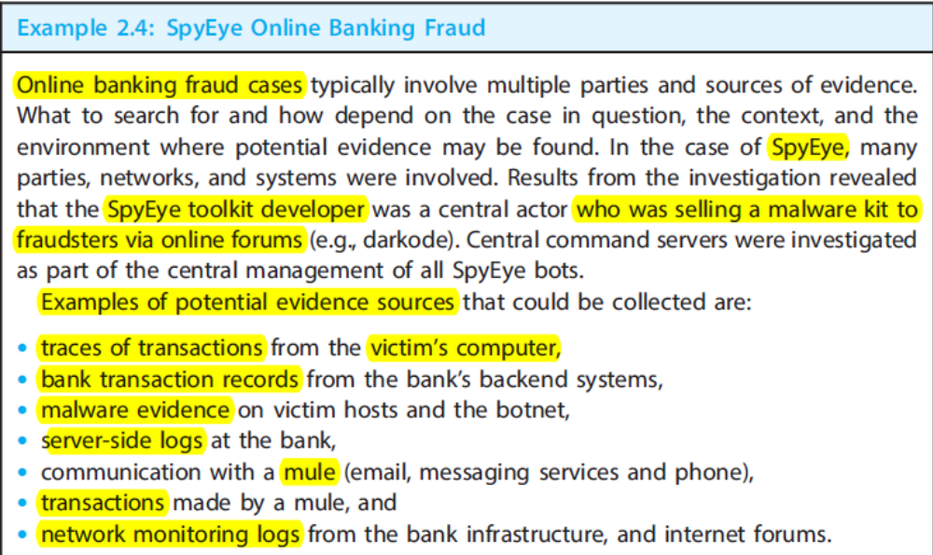
The Collection Phase (Contd.)
Acquisition or copying of the data: When a forensic investigator gains access to the electronic device(s) containing raw data that has been identified as relevant for the specific case.
Metadata: Metadata about a case should be tied to the potential evidence, whether it be a physical device or a data file. Such metadata can include the case name, case number, examiner (the digital forensics investigator or investigators), time stamps, case and seizure location, and time zone.
Notes:
Thus, what we are not going to learn is how to give evidence in court, what the specific laws are in relation to computer misuse. Nor are we going to cover the various organisational policies that you may encounter.
Instead, we are here to focus solely on the area of digital investigation. Evidence, thus, has a meaning in investigative context, and not in terms of the context of legal admissibility.
Thus this leads to the idea that digital investigation is influenced by the context in which it is undertaken. This module is concerned with Digital investigation. The outcome of this investigation may be used for a Forensic Investigation as part of a criminal case against an individual, or it may be used as part of an internal process. This is something that we are not going to teach as part of this course, as it is out of our remit.

Slide 16
The Collection Phase (Contd.)
Sources of Digital Evidence:
  Hard drives or other computer long-term storage media. Examples include a hard disk, and flash storage drives, main memory, GPU (graphics processing unit) memory, or a CPU with a cache, external devices that can be connected to a computer, such as removable media, memory sticks, web cameras, and CDs, DVDs, and Blu-rays.
  Embedded devices can have removable and integrated storage media with proprietary connectors and physical interfaces. Imagine a memory chip from a remote-controlled central garage opener, often used in apartment buildings that can hold information about which remote control keys were in use (if any) to open a gate at the time that a criminal broke into a car.
  Smartphones and tablets have become almost as widespread as traditional computing devices that can hold a lots of information relevant to a forensic investigation. For example, they may contain evidence of geographical movement and mobile network communications.
  Computer networks can hold vast amounts of digital evidence. Network forensics is often related to the monitoring and analysis of volatile and dynamic network traffic that covers both the traffic and the connected systems in digital forensics investigations. The Internet, the services and applications it offers, along with all users and company-generated data (blogs, online shops, forums, and chat services) provide additional sources of evidence.
Notes:
Thus, what we are not going to learn is how to give evidence in court, what the specific laws are in relation to computer misuse. Nor are we going to cover the various organisational policies that you may encounter.
Instead, we are here to focus solely on the area of digital investigation. Evidence, thus, has a meaning in investigative context, and not in terms of the context of legal admissibility.
Thus this leads to the idea that digital investigation is influenced by the context in which it is undertaken. This module is concerned with Digital investigation. The outcome of this investigation may be used for a Forensic Investigation as part of a criminal case against an individual, or it may be used as part of an internal process. This is something that we are not going to teach as part of this course, as it is out of our remit.

Slide 17
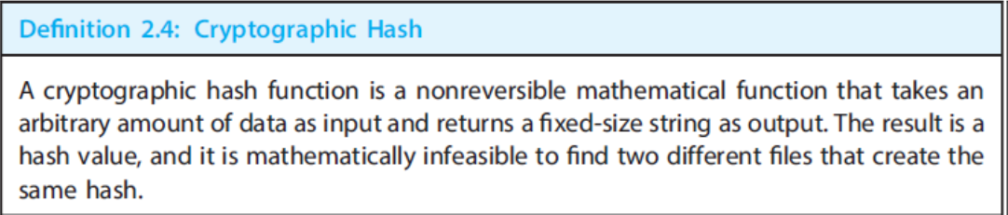
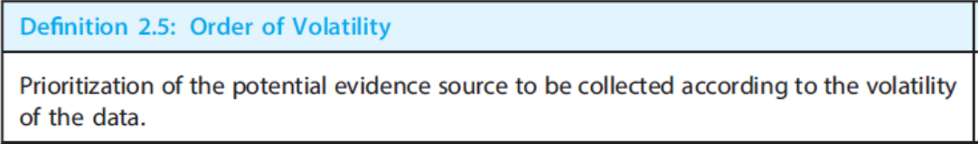
The Collection Phase (Contd.)
Systems Physically Tied to a Location: Not possible to move, or remove, a system or digital device from its physical location, the data needs to be copied at the physical location itself. A typical crime or incident could involve emails from a central corporate email server.
Multiple Evidence Sources: Relative to the case investigated, potential digital evidence can be present in multiple devices in one physical location or in several locations across the world.
Reconstruction: The collected media (or hardware) that stores data can be intentionally damaged by suspects trying to destroy evidence, or unintentionally, for example in a fire or accident. One cannot always expect to start copying data right away.
Evidence Integrity and Cryptographic Hashes: To ensure that evidence is neither accidentally nor intentionally changed when collecting digital data from an original source. Evidence integrity can be facilitated by using hardware or software write blockers and Digital fingerprinting that applies cryptographic (or one-way) hash functions. The input to a hash function is a bit stream, which can come from a file, a disk, or a partition, and the output is the unique hash or signature of that input stream. By comparing the hashes of an original with those of its respective copy
Order of Volatility:
Notes:
Thus, what we are not going to learn is how to give evidence in court, what the specific laws are in relation to computer misuse. Nor are we going to cover the various organisational policies that you may encounter.
Instead, we are here to focus solely on the area of digital investigation. Evidence, thus, has a meaning in investigative context, and not in terms of the context of legal admissibility.
Thus this leads to the idea that digital investigation is influenced by the context in which it is undertaken. This module is concerned with Digital investigation. The outcome of this investigation may be used for a Forensic Investigation as part of a criminal case against an individual, or it may be used as part of an internal process. This is something that we are not going to teach as part of this course, as it is out of our remit.

Slide 18
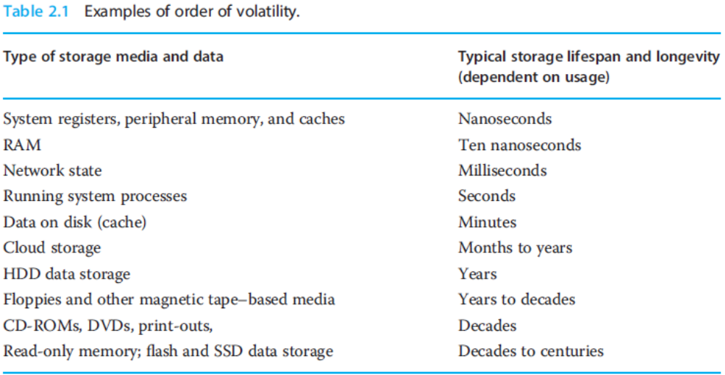
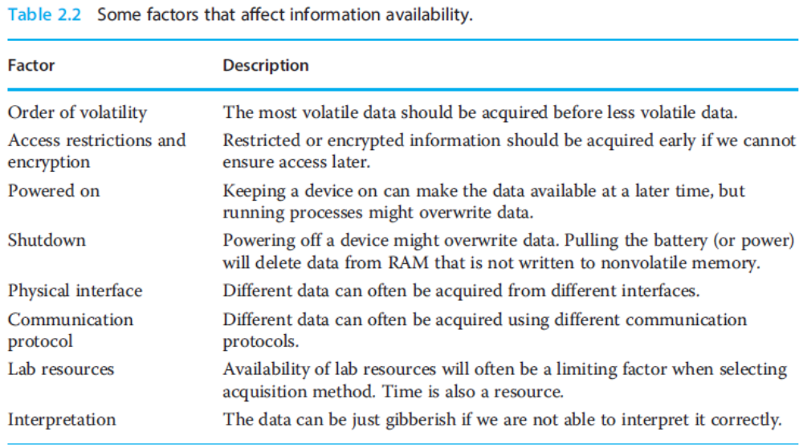
The Collection Phase (Contd.)
Notes:
Thus, what we are not going to learn is how to give evidence in court, what the specific laws are in relation to computer misuse. Nor are we going to cover the various organisational policies that you may encounter.
Instead, we are here to focus solely on the area of digital investigation. Evidence, thus, has a meaning in investigative context, and not in terms of the context of legal admissibility.
Thus this leads to the idea that digital investigation is influenced by the context in which it is undertaken. This module is concerned with Digital investigation. The outcome of this investigation may be used for a Forensic Investigation as part of a criminal case against an individual, or it may be used as part of an internal process. This is something that we are not going to teach as part of this course, as it is out of our remit.

Slide 19
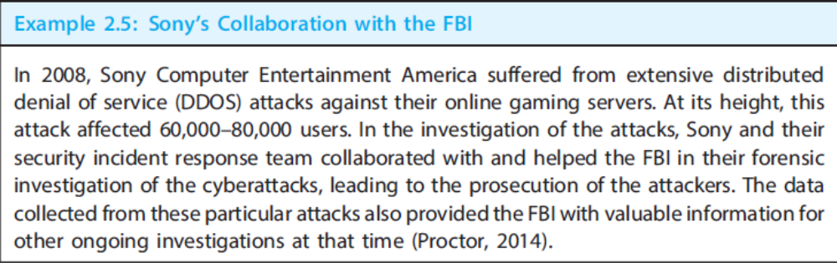
The Collection Phase (Contd.)
Dual-Tool Verification: Applied as a means to detect errors from one tool by using another tool to confirm the results. Example: extracting evidence from a broken memory stick. Through the use of an imaging tool to acquire a copy of the memory stick’s data storage, only 70% of the original storage space is collected. In order to check if a human or software error was the cause of this, another imaging tool could be used and the results compared. If there is a deviation between the results, further analysis will be needed to understand the root cause.
Remote Acquisition: Remote forensic acquisition can increase the speed of the investigation and reduce expenses. Further more, the more time it takes to arrive on-site and begin the collection, the more data may be lost. Many forensic software vendors include remote forensics capabilities in their tools, such as Guidance Software (EnCase), Access data (FTK), and Fire Eye.
External Competency and Forensics Cooperation: Cyber crime is one type of crime that can rarely be solved by police investigators from only one country, as the origin of the attack can be in one country, but the crime has an effect in another country.
Notes:
Thus, what we are not going to learn is how to give evidence in court, what the specific laws are in relation to computer misuse. Nor are we going to cover the various organisational policies that you may encounter.
Instead, we are here to focus solely on the area of digital investigation. Evidence, thus, has a meaning in investigative context, and not in terms of the context of legal admissibility.
Thus this leads to the idea that digital investigation is influenced by the context in which it is undertaken. This module is concerned with Digital investigation. The outcome of this investigation may be used for a Forensic Investigation as part of a criminal case against an individual, or it may be used as part of an internal process. This is something that we are not going to teach as part of this course, as it is out of our remit.

Slide 20
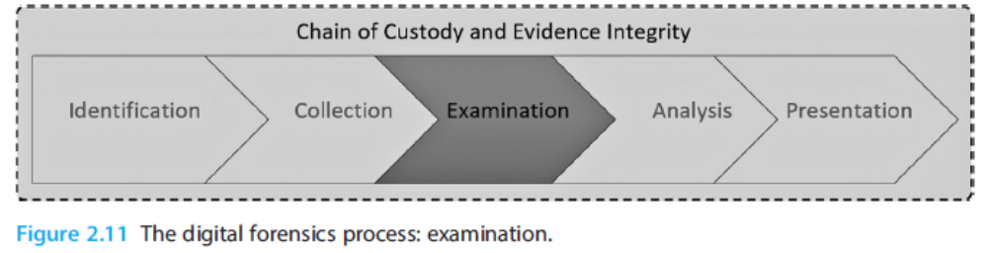
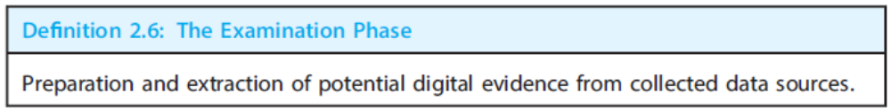
The Examination Phase
Notes:
Thus, what we are not going to learn is how to give evidence in court, what the specific laws are in relation to computer misuse. Nor are we going to cover the various organisational policies that you may encounter.
Instead, we are here to focus solely on the area of digital investigation. Evidence, thus, has a meaning in investigative context, and not in terms of the context of legal admissibility.
Thus this leads to the idea that digital investigation is influenced by the context in which it is undertaken. This module is concerned with Digital investigation. The outcome of this investigation may be used for a Forensic Investigation as part of a criminal case against an individual, or it may be used as part of an internal process. This is something that we are not going to teach as part of this course, as it is out of our remit.

Slide 21
The Examination Phase (Contd.)
Initial Data Source Examination and Preprocessing: A copy of the data source can be considered a “black box” of unstructured, binary data. The objective of the initial, basic examination of the data is to make it more structured and readable.
Forensic File Formats and Structures: The formatting of the copied data should clearly reflect the evidence tied to the incident investigated and provides as much additional information as possible. There are many different digital forensics formats, and the information storage capabilities of these formats have different impacts on the investigation results. First and foremost is the raw data format, which is used to copy the data source “as is.” The more extensive storage formats are EnCase, SMART, AFF, and Prodiscover. Examples of additional information include meta data extractions, integrity checks, archive decompressions, and file decryptions.
Data Recovery: In most modern file systems, only the pointer to the file is marked “available” or “unallocated.” This results in the space being available, and a new file can overwrite the previous file. Data can thus be recovered from the storage area even after deletion of a file, as long as the data are a was not overwritten. Example: if an image were deleted years prior to an investigation, parts of the image might still be extracted. The image data can be rebuilt in a viewer, and it will represent the original material and its content, even though other details or portions of the data are missing.
Notes:
Thus, what we are not going to learn is how to give evidence in court, what the specific laws are in relation to computer misuse. Nor are we going to cover the various organisational policies that you may encounter.
Instead, we are here to focus solely on the area of digital investigation. Evidence, thus, has a meaning in investigative context, and not in terms of the context of legal admissibility.
Thus this leads to the idea that digital investigation is influenced by the context in which it is undertaken. This module is concerned with Digital investigation. The outcome of this investigation may be used for a Forensic Investigation as part of a criminal case against an individual, or it may be used as part of an internal process. This is something that we are not going to teach as part of this course, as it is out of our remit.

Slide 22
The Examination Phase (Contd.)
Data Reduction and Filtering: Large amounts of data present a challenge for effective digital forensics investigations. A single digital device may hold terabytes of data from billions of files. All methods for safely reducing the data volume should be considered. Filtering is an example of a method that can be used during examination.
Timestamps: The recording of correct timestamps in an investigation can help identify correlations across multiple data objects.
Compression, Encryption and Obfuscation: During the examination phase, compressed files should be uncompressed, and encrypted files should be decrypted if possible. It can also be that obscurity techniques have been applied to complicate the identification of potential evidence.
Data and File Carving: When data is collected from a data source, a forensic investigator may find it unstructured and difficult to interpret. In order not to overlook potential evidence, there are tools and techniques available for parsing or carving unstructured and sometimes raw binary data.
Automation: Automation is an objective to ensure both forensic soundness and efficiency. Most of the tasks in the examination phase can be automated using scripts or programs. File parsing, string searches, and extraction of compressed files will significantly reduce the manual task load on an investigator, in particular when working with large datasets. The most common digital forensic tools, such as EnCase, offer special-purpose scripting languages to help automate tasks.
Notes:
Thus, what we are not going to learn is how to give evidence in court, what the specific laws are in relation to computer misuse. Nor are we going to cover the various organisational policies that you may encounter.
Instead, we are here to focus solely on the area of digital investigation. Evidence, thus, has a meaning in investigative context, and not in terms of the context of legal admissibility.
Thus this leads to the idea that digital investigation is influenced by the context in which it is undertaken. This module is concerned with Digital investigation. The outcome of this investigation may be used for a Forensic Investigation as part of a criminal case against an individual, or it may be used as part of an internal process. This is something that we are not going to teach as part of this course, as it is out of our remit.

Slide 23
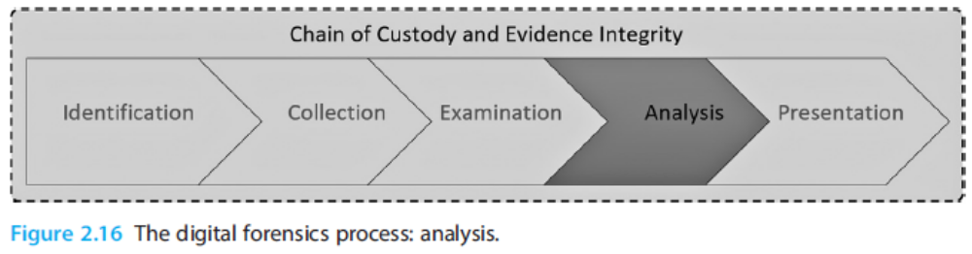
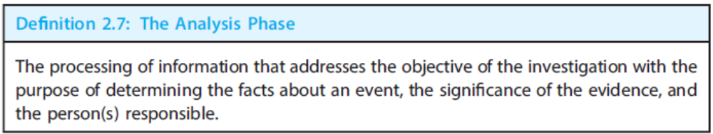
The Analysis Phase
Notes:
Thus, what we are not going to learn is how to give evidence in court, what the specific laws are in relation to computer misuse. Nor are we going to cover the various organisational policies that you may encounter.
Instead, we are here to focus solely on the area of digital investigation. Evidence, thus, has a meaning in investigative context, and not in terms of the context of legal admissibility.
Thus this leads to the idea that digital investigation is influenced by the context in which it is undertaken. This module is concerned with Digital investigation. The outcome of this investigation may be used for a Forensic Investigation as part of a criminal case against an individual, or it may be used as part of an internal process. This is something that we are not going to teach as part of this course, as it is out of our remit.

Slide 24
The Analysis Phase (Contd.)
Layers of Abstraction: What you see is not always what you get. One has to recognize this as a fact when analyzing digital media, regardless of the storage media chosen. In the case of file system forensics, data seen by an application is not the same as what is seen by an operating system and, again, not the same as what is actually stored in bits and bytes on the storage device.
Evidence Types: Any case will have its own evidence, depending on the type of crime. For example, the evidence of a physical crime, where clues regarding the motivation of the crime can be found in a digital device owned by the suspect or the victim, will be much different from the evidence of a cybercrime conducted from a computer.
String and Keyword Searches: String and keyword searches is a targeted analysis technique that can be used if one knows what to look for. Imagine an illegal drug case where the investigation was triggered based on a reported crime with specific information about a person and a certain drug or its code name. The name of the person or the drug can be used as a keyword to search through the potential evidence media sources. Keyword searches can be automated or scripted with the use of forensic tools.
Anti-Forensics: Certain techniques are used to make forensic analysis of digital evidence even harder. Are deliberate attempts to increase the difficulty of performing digital forensics by eliminating or reducing the ability to access evidence.
Notes:
Thus, what we are not going to learn is how to give evidence in court, what the specific laws are in relation to computer misuse. Nor are we going to cover the various organisational policies that you may encounter.
Instead, we are here to focus solely on the area of digital investigation. Evidence, thus, has a meaning in investigative context, and not in terms of the context of legal admissibility.
Thus this leads to the idea that digital investigation is influenced by the context in which it is undertaken. This module is concerned with Digital investigation. The outcome of this investigation may be used for a Forensic Investigation as part of a criminal case against an individual, or it may be used as part of an internal process. This is something that we are not going to teach as part of this course, as it is out of our remit.

Slide 25
The Analysis Phase (Contd.)
Automated Analysis: Large data volumes, obfuscated malware, and techniques to remove their traces make it time-consuming, costly, and difficult for forensic personnel to identify and analyze relevant evidence. This is especially difficult when evidence is present over a large collection of computers. Computational forensics discusses methods for analyzing large amounts of data or highly unstructured datasets that are otherwise difficult to analyze manually. Data mining, especially link-mining techniques, can be applied to the large and complex datasets collected during investigations.
Timelining of Events: Timelining is a powerful tool for forensic analysis and contextual awareness. Many forensic tools can automatically structure files and data based on the time they were accessed, last changed, or deleted..
Graphs and Visual Representations: The relationships between data objects, individuals, files, and network interactions are all easier to grasp when presented graphically. Many applications and tools exist to present data in a visual manner that is based on a set of common attributes, such as email addresses found across a set of digital devices related to a crime or an incident.
Link Analysis: A powerful and emerging discipline in digital forensics. The goal of link analysis is to produce a structured presentation of interconnected and linked objects. One can gain a better understanding of the relationships and associations among them when links are visualized in graphs, for example where nodes in the graph represent entities and objects.
Notes:
Thus, what we are not going to learn is how to give evidence in court, what the specific laws are in relation to computer misuse. Nor are we going to cover the various organisational policies that you may encounter.
Instead, we are here to focus solely on the area of digital investigation. Evidence, thus, has a meaning in investigative context, and not in terms of the context of legal admissibility.
Thus this leads to the idea that digital investigation is influenced by the context in which it is undertaken. This module is concerned with Digital investigation. The outcome of this investigation may be used for a Forensic Investigation as part of a criminal case against an individual, or it may be used as part of an internal process. This is something that we are not going to teach as part of this course, as it is out of our remit.

Slide 26
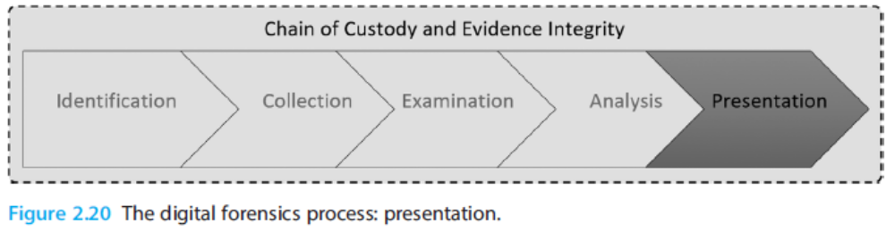
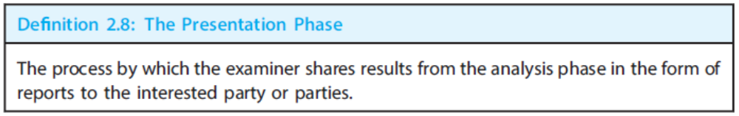
The Presentation Phase
Notes:
Thus, what we are not going to learn is how to give evidence in court, what the specific laws are in relation to computer misuse. Nor are we going to cover the various organisational policies that you may encounter.
Instead, we are here to focus solely on the area of digital investigation. Evidence, thus, has a meaning in investigative context, and not in terms of the context of legal admissibility.
Thus this leads to the idea that digital investigation is influenced by the context in which it is undertaken. This module is concerned with Digital investigation. The outcome of this investigation may be used for a Forensic Investigation as part of a criminal case against an individual, or it may be used as part of an internal process. This is something that we are not going to teach as part of this course, as it is out of our remit.

Slide 27
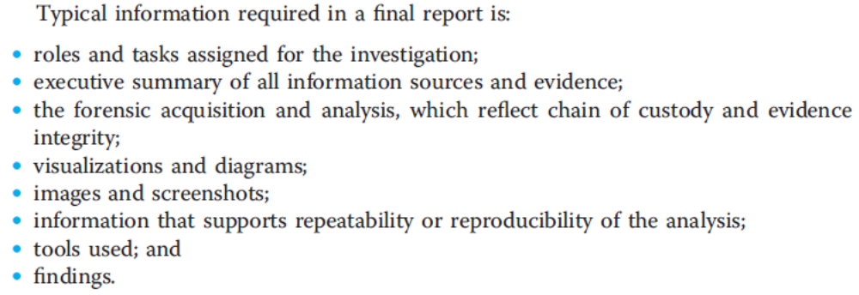
The Presentation Phase (Contd.)
The Final Reports: This means that the investigator must be able to prepare the gathered information so that it is understandable to a third party. Ultimately, this is the purpose of the investigation: to present the findings in a clear and understandable manner.
Presentation of Evidence and Work Conducted: Presenting the final report professionally and in a form at that is rich with visual aids will make the complex and unstructured information available in an easy and understandable way. Diagrams, graphics, and timelines are powerful tools to make the findings more accessible.
The Chain of Custody Circle Closes: The documented chain of custody is the glue that holds the forensics process together and supports the final evidence integrity so that it can be presented as trustworthy evidence in court.
Notes:
Thus, what we are not going to learn is how to give evidence in court, what the specific laws are in relation to computer misuse. Nor are we going to cover the various organisational policies that you may encounter.
Instead, we are here to focus solely on the area of digital investigation. Evidence, thus, has a meaning in investigative context, and not in terms of the context of legal admissibility.
Thus this leads to the idea that digital investigation is influenced by the context in which it is undertaken. This module is concerned with Digital investigation. The outcome of this investigation may be used for a Forensic Investigation as part of a criminal case against an individual, or it may be used as part of an internal process. This is something that we are not going to teach as part of this course, as it is out of our remit.

Slide 28
Thank You!

